Slide 1

DISEASE RECOGNITION USING NAIL SAMPLES
BACHELOR OF ENGINEERING
IN
TELECOMMUNICATION ENGINEERING
MACHINE LEARNING
For the Academic Year 2019-2020
Submitted by
NEEHAR CHANDAVARKAR (1MS17TE027)
NEHA MUKUND R (1MS17TE028)
MUSKAAN GUPTA (1MS17TE063)

Slide 2
AIM
The project is based on finding the disease a human may be prone to just by analyzing his/her nails. It uses machine learning and convolutional neural networks.
The main aim of this system design is to provide an application for use in healthcare domain for prediction of diseases.
The proposed system will take nail image as an input and will perform processing on input image. Then finally it will predict probable diseases.

Slide 3
INTRODUCTION
In health care domain many diseases can be predicted by observing color of human nails. Doctors observe nails of patient to get assistance in disease identification. Usually pink nails indicate healthy human.
The need of system to analyze nails for disease prediction is because human eye is having subjectivity about colors, having limitation in resolution and small amount of color change in few pixels on nail would not be highlighted to human eyes which may lead to wrong result where as computer recognizes small color changes on nail.
In this system human nail image is captured using camera. Captured image is uploaded onto a system and region of interest from nail area is selected from uploaded image manually. The selected area is then processed further for extracting features of nail such as color of nail.
This color feature of nail is matched using simple matcher algorithm for disease prediction. In this way the system is useful in prediction of diseases in their initial stages.

Slide 4
PROBLEM STATEMENT
In health care domain doctors observe human nails as supporting information or symptoms for certain disease prediction. The same task is defined by the proposed model without any human intervention.
The model gives more accurate results than human vision, errors because it overcomes the limitations of human eye like subjectivity and resolution power.

Slide 5

OBJECTIVES
The main objective of this system design is to provide an application for use in healthcare domain.
The proposed model is advantageous in terms of cost and time.
The proposed system will take nail image as an input and will perform processing on input image.
Then finally it will predict probable diseases. This system can be used by people as well as by doctors in healthcare domain.

Slide 6
MOTIVATION
Large population having limited access to medical fraternity and facility, eliminate common errors done during diagnosis by medical professionals, missing standard operating procedures are a few motivating factors to design a simplified process, thereby providing accurate error free treatment there on.

Slide 7
ALGORITHM USED
The name “convolutional neural network” indicates that the network employs a mathematical operation called convolution.Convolution is a specialized kind of linear operation. Convolutional networks are simply neural networks that use convolution in place of general matrix multiplication in at least one of their layers.
A convolutional neural network consists of an input and an output layer, as well as multiple hidden layers. The activation function is commonly a RELU layer, and is subsequently followed by additional convolutions such as pooling layers, fully connected layers and normalization layers, referred to as hidden layers because their inputs and outputs are masked by the activation function and final convolution.
When programming a CNN, the input is a tensor with shape (number of images) x (image width) x (image height) x (image depth). Then after passing through a convolutional layer, the image becomes abstracted to a feature map, with shape (number of images) x (feature map width) x (feature map height) x (feature map channels).

Slide 8
ALGORITHM USED CONTD..
A convolutional layer within a neural network should have the following attributes:
1. Convolutional kernels defined by a width and height (hyper-parameters).
2. The number of input channels and output channels (hyper-parameter).
3. The depth of the Convolution filter (the input channels) must be equal to the number channels (depth) of the input feature map.
Convolutional layers convolve the input and pass its result to the next layer. This is similar to the response of a neuron in the visual cortex to a specific stimulus.
Pooling: Convolutional networks may include local or global pooling layers to streamline the underlying computation. Pooling layers reduce the dimensions of the data by combining the outputs of neuron clusters at one layer into a single neuron in the next layer. Local pooling combines small clusters, typically 2 x 2. Global pooling acts on all the neurons of the convolutional layer.
In addition, pooling may compute a max or an average. Max pooling uses the maximum value from each of a cluster of neurons at the prior layer.
ReLU layer:ReLU is the abbreviation of rectified linear unit, which applies the non-saturating activation function {\textstyle f(x)=\max(0,x)}.

Slide 9
ALGORITHM FLOW CONTD..
The proposed system guides in such scenario to take decision in disease diagnosis. The input to the proposed system is person nail image. The system will process an image of nail and extract features of nail which is used for disease diagnosis.
Human nail consist of various features, out of which proposed system uses nail color changes for disease diagnosis. Here, first training set data is prepared using CNN from nail images of patients of specific diseases. A feature extracted from input nail image is compared with the training data set to get result.
Human fingernail image analysis is procedure consists of image capturing, pre-processing of image, image segmentation, segmentation of image, feature extraction
The nail features such as color, shape and texture used to predict diseases.

Slide 10
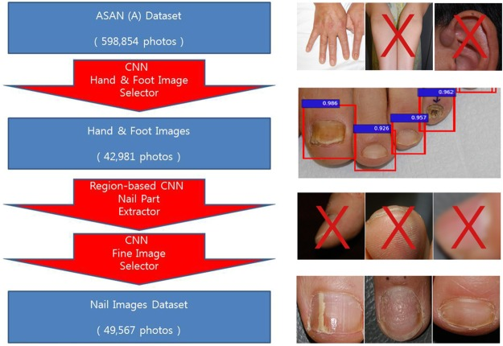
FLOW PROCESS

Slide 11
CONCLUSIONS AND FUTURE SCOPE
Health is a critical aspect for Human life. Identification of human health conditions and accurately predicting the symptoms of the diseases is useful work for the society.
Nail colors are used for the disease detection. It helps in recognizing disease of the person and minimize the cost of the diagnosis of diseases. The detection system makes easy for doctors to give correct treatment to patients.
The system can be made better with increased number of image samples.
The future scope includes making the refining of the expectant results via the image.

Slide 12
REFERENCES
1.Indi Trupti, Yogesh A. Gunge, “Early Stage Disease Diagnosis System Using Human Nail Image Processing”, I.J. Information Technology AndComputer Science, Vol. 7, Pp.30-35 , 05-07-2016
2.Sneha Gandhat, A. D. Thakare, Swati Avhad,Nityash Bajpai, Rohit Alawadhi, “ Study And Analysis Of Nail Images Of Patients”,International Journal Of Computer Applications,Volume 143 – No.13, June 2016
3.Vipra Sharma, Aparajit Shrivastava, ”System For Disease Detection By Analyzing Fingernails Color And Texture”,International Journal Of Advanced Engineering Research And Science (Ijaers), Vol-2,Issue-10, Oct- 2015.
4.V.Saranya,Dr.A.Ranichitra,”Image Segmentation Techniques To Detect Nail Abnormalities”,International Journal Of Computer Technology & Applications, Vol.-8, Issue- 4,Pp.522-527, 2017.
5.VipraSharma , Manoj Ramaiya, “Nail Color And Texture Analysis For Disease Detection” ,International Journal Of Bio-Science And Bio-Technology, Pp.351-358, Vol.7, Issue – 5, 2015.

Slide 13
Thank You!

